Slide 1
First CSI Regional Youth Conference in Moldova, May 3, 2016
2016 Youth Conf REPORT 2016 Moldova

Slide 2
May 3, 2016, Camp “Vifania”, North of Moldova
Theme of Youth Conference:
The Great Commandment is Personal

Slide 3
Goals and objectives of Youth CSI Conference
To make an emphasis on the importance of participating in the fulfillment of the Great Commandment of our Lord Jesus Christ, by teaching the world, mainly members of the family, relatives, friends and co-workers the Bible truths.
To introduce the CSI strategy.
To train how to use the CSI materials in teaching grown- ups and children.
To teach how to organize Bible Clubs for Children in the homes of Christians.

Slide 4
Participants of the Conference
The conference was organized in the Christian summer camp “Bethany”.
It drew up 240 participants who came from the 6 zones of the Balti region, Moldova.
The youth learned about the CSI strategy and had a lot of fun by having fellowship, games and sports.

Slide 5
240 youth representing the 106 Baptist Churches of the Balti area in First CSI Youth Conference in Moldova, May 3,2016

Slide 6
Greeting of Bill Davis, President and founder of CSI to the youth
The President of CSI, Rev. Bill Davis, has addressed a letter to the participants of the Conference, challenging them to join in the reaping the harvest, expressing his belief that Youth can become a leading force in fulfilling he great Commission of Christ, in bringing children and their parents into church.

Slide 7
The program was presented by Stella Gorbani, the CSI translator. She presented the CSI strategy and history, introducing the story of Bill Davis’ vision which became the starting point of the whole program.

Slide 8
Stella spoke about the interactive methods of teaching CSI materials and ways of organizing Bible clubs for kids in summer time, which is a promising way of opening a new perspective for the youth ministry in the world.

Slide 9
Young boys and girls received the program with much enthusiasm. They loved the structure of the Lessons, the method and coloring the pictures. This motivated them to be involved in the training and we believe in using this program with the kids of their villages. Some could not help starting coloring the pictures right during the presentation and remember about the lovely time of their childhood.

Slide 10
How to organize Bible Clubs for Children.

Slide 11
Portfolios for each youth
Contained:
1. “ Is God Calling me?” – 5 copies of each lesson.
2. “God’s Eternity Quiz” – 10 copies.
3. OT - 1 series, lessons 1-6 – 5 copies of each lesson.
4. NT -1 series, Lessons 1-6 – 5 copies of each lesson.
Each of these materials were presented in Romanian and Russian, the two languages which circulate in Moldova.

Slide 12
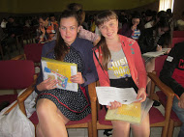
Materials of the conference

Slide 13
Youth gave a very positive feedback to the program and to the opportunity for serving our Lord.

Slide 14
They all liked the materials and the interactive method of teaching, getting involved in the lesson presentations.

Slide 15
Model of Teaching OT 1 series
Alina Gopa, the CSI volunteer, has demonstrated how to teach a lesson from “Stories for All Ages”, by presenting lesson 3 from OT -1 “Disobedience Ruins Everything!”, which was a clear example for the young people how to teach CSI materials to Children.

Slide 16
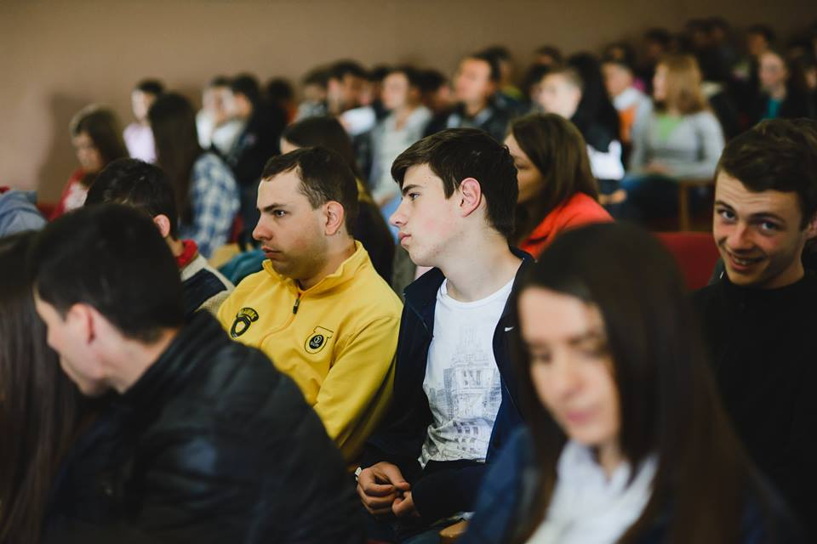
Many young people are ready to use this materials because they are easy to use. Some got absorbed in coloring the pictures which proves once again how effective and attractive the “Stories for All Ages” are.

Slide 17
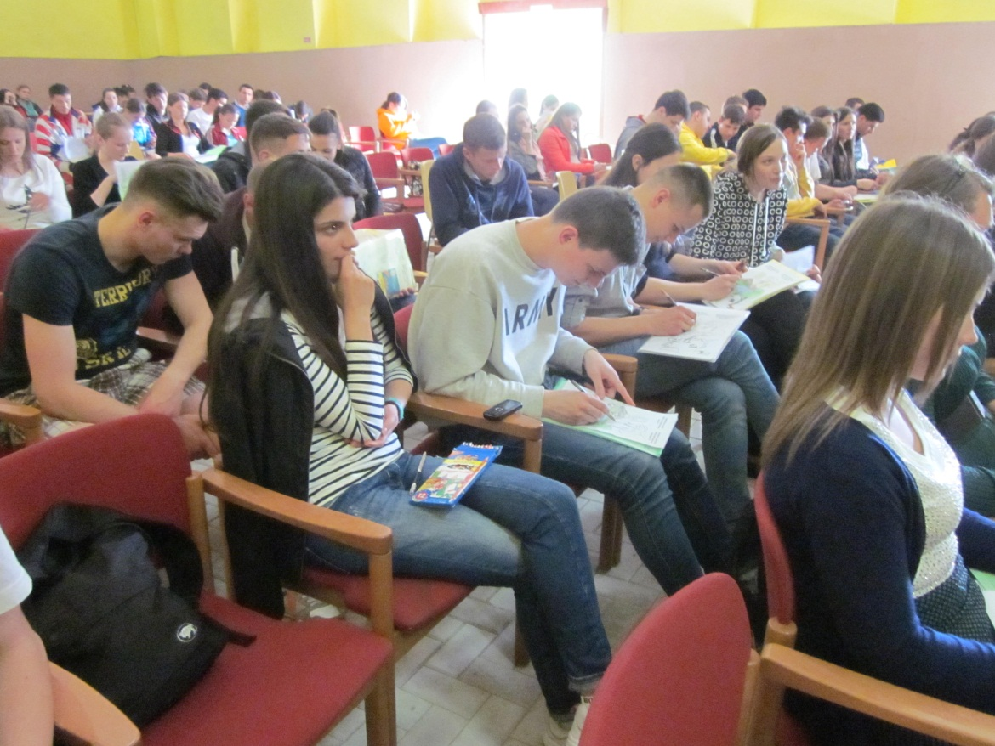
The youth forming a vision about how to work with kids for the glory of God

Slide 18
“The Super 13”
The youth was most encouraged to hear about the “Super 13”. This is a group of 6 teenagers who started teaching the “Stories of all ages” to their friends and kids from their neighborhood. They came to a Youth conference for the first time in their life, but with a beautiful story about how they love Christ and how they participate in building His Kingdom at this early age, using the CSI materials.
If a teenager can teach these materials, how much more potential have the Christians and the youth who have given their hearts to LORD.

Slide 19
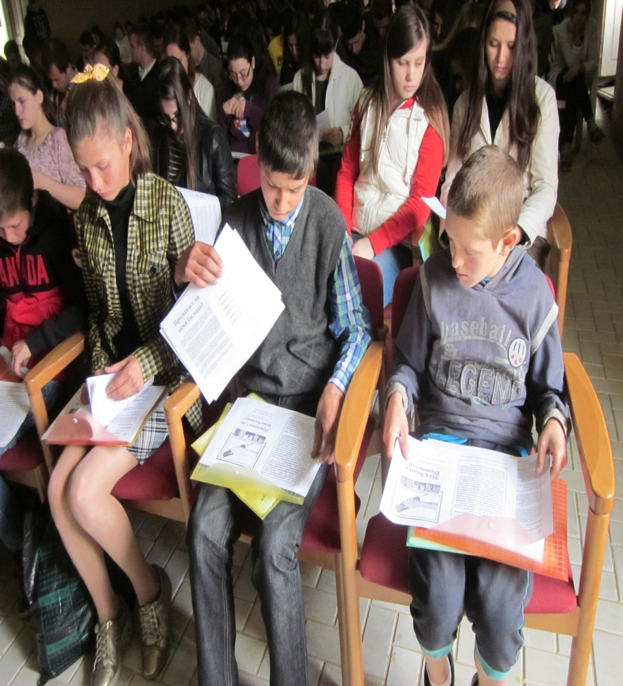
The Super 13, who participated in the program, told everybody about the way they teach children in their villages the Bible truths, using “ Stories for all Ages”

Slide 20
Tanea Legcun, another CSI volunteer, presented the story about the Bible Clubs opened in Moldova by the Women who had been in the CSI Women Conferences in Moldova in 2015.

Slide 21
Tanea illustrated the events with pictures from the Bible Clubs which are such a joy for the kids to attend in various villages of the North Region of Moldova.

Slide 22
The Super 13 gave an interview about their experience of conducting Bible Clubs in their neighborhood
Tanea interviewed the 3 girls who lead 3 different BC in their native villages. They have learned the method from their Sunday school teacher.

Slide 23
Question: Why do you like to teach the Bible stories for all ages, Svetlana?
Answer: Because it is very simple. The teacher just names the pupils and the kids have to do all themselves - they read the text one by one, they read the questions, they answer the questions and retell the story. The teacher has just to follow them not to make mistakes and find the correct answers in the text.
It I s fun to teach.

Slide 24
Question: What do kids like about Bible Clubs.
Answer: They like to be together, to study the stories. The stories are very unusual and interesting. They like to think about how they would act in a similar situation. And of course they like to color the picture. Besides, they like to take the pictures home for their parents to see. We have a lot of fun - we have tea with cookies, we play games and sing the Christian kid’s songs sister Stella teaches us in the Sunday school. We love the Bible Clubs!

Slide 25
At the end of the program it was made a call for the youth to share their impressions about this program and the CSI strategy and materials. This is what they said:
Serghei, Falesti church:
“The work with kids is very important. It requires a lot of responsibility. If you start it, make sure that you will continue it. You can not deceive children. They are very opened and they deserve to be loved and to know about Christ. I am going to use this wonderful material this summer. We have a lot of kids in the villages around who nobody teaches about Christ.”

Slide 26
Mark Sandu , Grigoresti:
“My Dad is using these materials for many years. Kids love them, the stories and the coloring. It helps teach them about God. ”(Mark is the son of Valentine Sandu, the Pastor who has been teaching “People who Knew Jesus” for many years.
Some time ago one of his disciples was a school teacher who went to Italy to make a better living. She met a group of elderly people who knew nothing about salvation. She taught these lessons to 20 elderly people and each of them received Christ).

Slide 27
Mihailo, city of Reni, the Ukrain:
“I am very happy to be with you all. I come from Ukraine, from the city pf Reni, down South. I liked this program very much. The lessons seem to be easy to teach. It is wonderful that there are ready lessons and the teacher does not need to elaborate lesson plans. They are ready. It is wonderful that each child has in front of himself the lesson with the text and questions. That they come on separate sheets, which kids can take home. It is very important to teach kids about Christ today. Kids are the future of our churches. If we have kids in church today – we shall have church tomorrow, if we have no kids today in church we shall have no church tomorrow ”.

Slide 28
Marina Tapcova, Balti, the Arc Church: “These are very good materials. My Mom and Dad were using these lessons in our Sunday school. We all loved them very much. I remembered my childhood. When I was a kid my Dad. They helped us understand the Bible because they tell the Bible truths in simple language. Kids understand them very well. And no doubt, they like to color the pictures. Thank you for teaching our youth how to use the materials.
I am sure they can do a lot with these materials!”.

Slide 29
The second part of the day was a time of fellowship, games and sports. All loved the CSI conference and were grateful to Lord and CSI for such an the opportunity to be together, meet their friends from other churches and make new friends again!

